Slide 1
TELECOMMUNICATIONS MANAGEMENT SYSTEM

Slide 2
About the Project
Telecommunications, our project mainly focuses on storing the customer details, provided plans, and tracking their calls.
The main goal of this project is to provide the call duration and charges(is any) for selected customers.

Slide 3
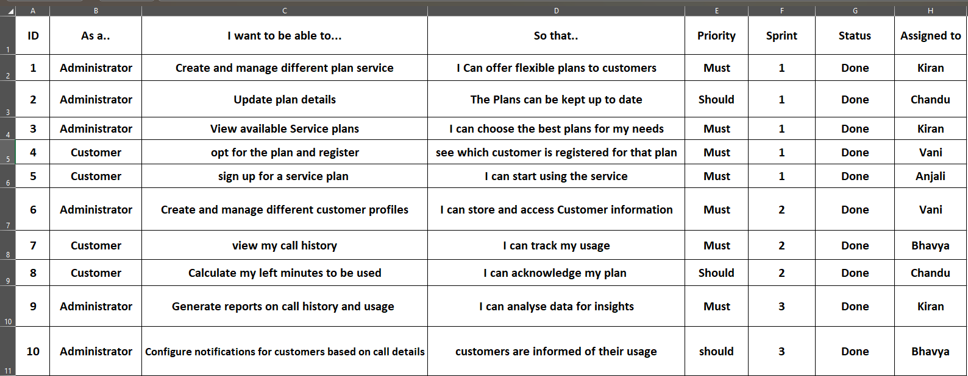
PRODUCT BACKLOG

Slide 4
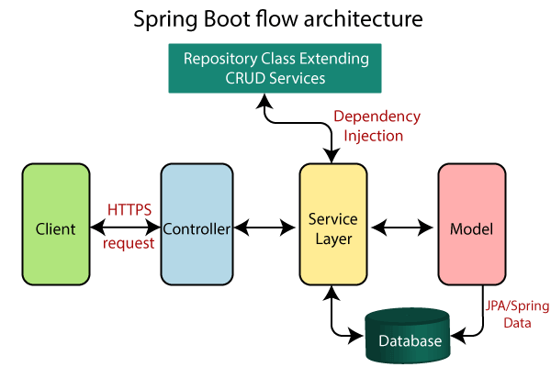
SPRINGBOOT FRAMEWORK

Slide 5
Model classes :-
Customer :-
cid;
cname;
phn;
email;
location;
registerDate;
Plan :-
pid;
pname;
validity;
duration_in_mins;
cost;
Call details:-
callId
call_duration
from_number
to_number
cid
pid

Slide 6
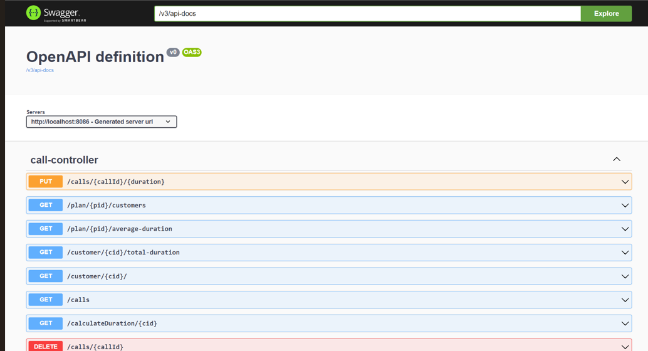
Swagger :-

Slide 7
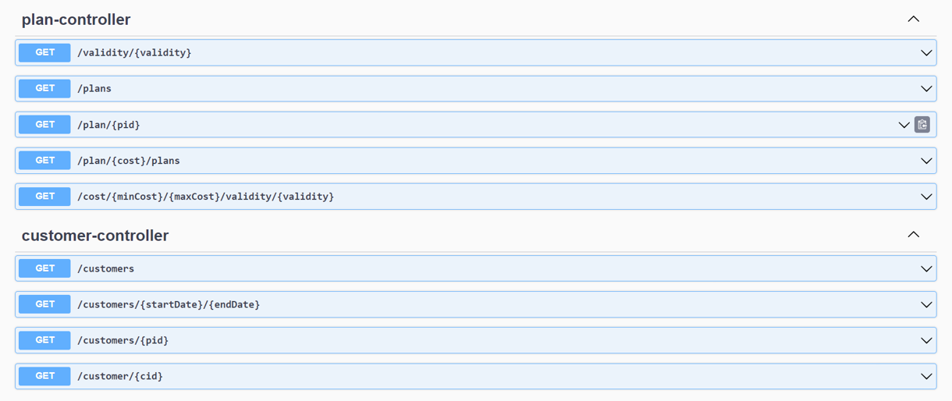

Slide 8
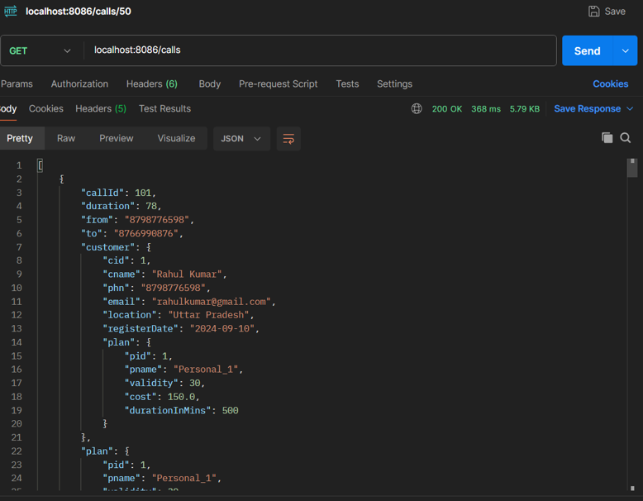
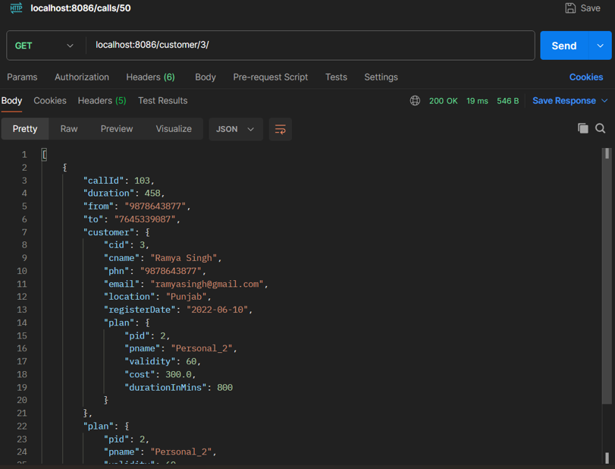
Outputs in postman:-

Slide 9
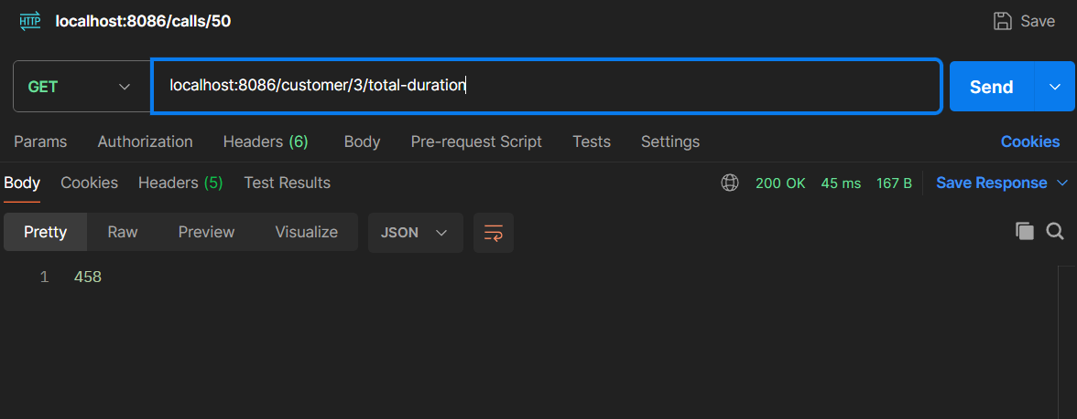
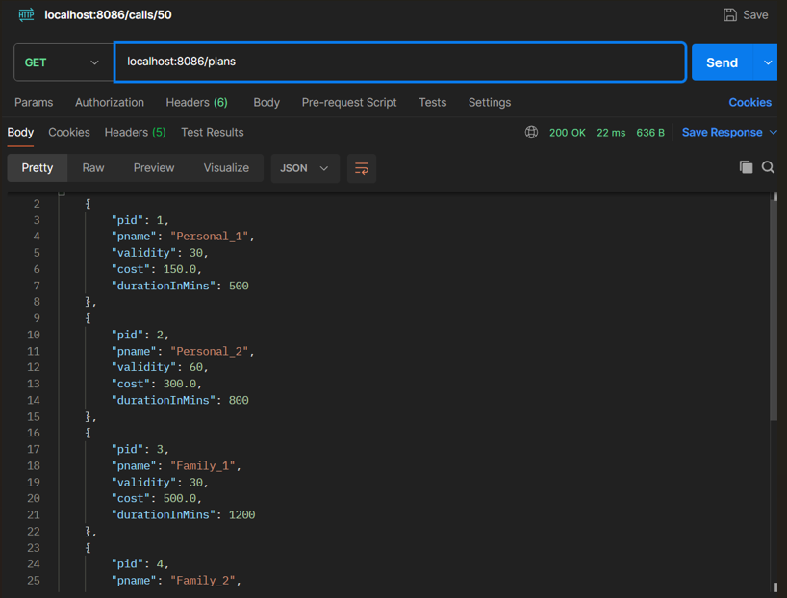
Outputs :-

Slide 10
Thank you

